Slide 1
DSC 530 Final Project
Tuck drace

Slide 2
The Dataset
The dataset are nursing home quality control metrics from the Centers of Medicare & Medicaid Services (CMS). Data is collected quarterly and published annually. The survey collects percentages of patients who register as experiencing increased pain, needing more help with daily activities, whether the patient is experiencing a long-term (90+ days) or short term (< 90 days) stay. It categorizes nursing homes by states, addresses, and overall score.

Slide 3
The statistical question
What are the relationships between long-term nursing home residents reporting that they are experiencing increased need for help in daily activities, and short-term nursing home residents reporting that they are experiencing increased moderate or severe pain, in states with more than 500 nursing homes?

Slide 4
The variables chosen
• PROVNUM: the unique Medicare identifier for a nursing home qualified to submit billing claims
• PROVNAME: the name of the nursing home
• STATE: the State in which the nursing home operates
• MSR_DESCR: quality to be measured, which for this exercise are the percentage of long-term residents who report that their needs for daily help with activities have increased, and the percentage of short-term residents who report moderate to severe pain during their stay.

Slide 5
The variables chosen
• STAY_TYPE: Long Stay or Short Stay, Long Stay being defined as a stay of over 90 days, and Short Stay being defined as a stay under 90 days.
• Q1_MEASURE_SCORE: Q1 2018 measurements of MSR_DESCR
• Q2_MEASURE_SCORE: Q2 2018 measurements of MSR_DESCR
• Q3_MEASURE_SCORE: Q3 2018 measurements of MSR_DESCR
• Q4_MEASURE_SCORE: Q4 2018 measurements of MSR_DESCR
• MEASURE_SCORE_4QTR_AVG: Average percentage across all four quarters of 2018.

Slide 6
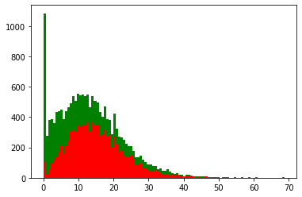
Histogram of Q1 MSR metrics
Green are long-term residents reporting increased need for help with daily activities.
Red are short-term residents reporting experiencing moderate to severe pain.
The histogram for Q1 demonstrates that a significant portion of long-term residents do not report an increased need for help with daily activities, while a significant portion of short-term residents report experiencing moderate to severe pain. It seems important to capture all of this data and so we will not eliminate any points.

Slide 7
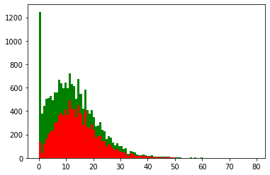
Histogram of Q2 MSR metrics
Green are long-term residents reporting increased need for help with daily activities.
Red are short-term residents reporting experiencing moderate to severe pain.
The histogram for Q2 demonstrates that a significant portion of long-term residents do not report an increased need for help with daily activities, while a significant portion of short-term residents report experiencing moderate to severe pain. It seems important to capture all of this data and so we will not eliminate any points.

Slide 8
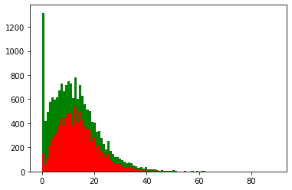
Histogram of Q3 MSR metrics
Green are long-term residents reporting increased need for help with daily activities.
Red are short-term residents reporting experiencing moderate to severe pain.
The histogram for Q3 demonstrates that a significant portion of long-term residents do not report an increased need for help with daily activities, while a significant portion of short-term residents report experiencing moderate to severe pain. It seems important to capture all of this data and so we will not eliminate any points.

Slide 9
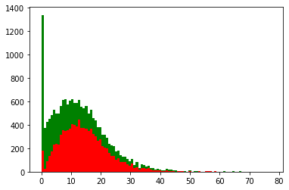
Histogram of Q4 MSR metrics
Green are long-term residents reporting increased need for help with daily activities.
Red are short-term residents reporting experiencing moderate to severe pain.
The histogram for Q4 demonstrates that a significant portion of long-term residents do not report an increased need for help with daily activities, while a significant portion of short-term residents report experiencing moderate to severe pain. It seems important to capture all of this data and so we will not eliminate any points.

Slide 10
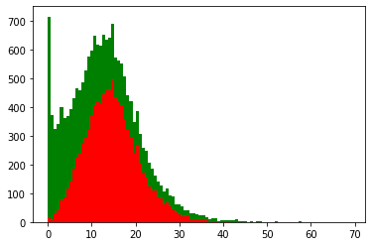
Histogram of four-quarter average
Green are long-term residents reporting increased need for help with daily activities.
Red are short-term residents reporting experiencing moderate to severe pain.
The average histogram of all four quarters.

Slide 11
Descriptive statistics of long-term residents reporting increased need for help with daily activities
 | Q1_MEASURE_SCORE | Q2_MEASURE_SCORE | Q3_MEASURE_SCORE | Q4_MEASURE_SCORE | MEASURE_SCORE_4QTR_AVG
count | 9699.000000 | 9699.000000 | 9699.000000 | 9699.000000 | 9699.000000
mean | 15.409362 | 14.371284 | 14.101325 | 14.521450 | 14.605257
std | 8.256542 | 8.121165 | 8.006323 | 8.087188 | 6.099655
min | 0.000000 | 0.000000 | 0.000000 | 0.000000 | 0.000000
25% | 9.562020 | 8.695650 | 8.394280 | 8.750000 | 10.360359
50% | 14.285710 | 13.274340 | 13.095240 | 13.513510 | 14.207651
75% | 20.000000 | 18.908280 | 18.367350 | 19.004130 | 18.229167
max | 65.625000 | 79.207920 | 89.090910 | 77.500000 | 52.142857

Slide 12
Descriptive statistics of short-term residents reporting experiencing moderate to severe pain
 | Q1_MEASURE_SCORE | Q2_MEASURE_SCORE | Q3_MEASURE_SCORE | Q4_MEASURE_SCORE | MEASURE_SCORE_4QTR_AVG
count | 7969.000000 | 7969.000000 | 7969.000000 | 7969.000000 | 7969.000000
mean | 10.998312 | 10.641955 | 10.852328 | 10.675108 | 10.777399
std | 9.653358 | 9.540920 | 9.842669 | 9.855211 | 8.940395
min | 0.000000 | 0.000000 | 0.000000 | 0.000000 | 0.000000
25% | 3.157890 | 2.868850 | 2.884620 | 2.666670 | 3.448275
50% | 8.943090 | 8.571430 | 8.695650 | 8.333330 | 9.122806
75% | 16.666670 | 16.088330 | 16.216220 | 16.176470 | 15.950919
max | 68.750000 | 69.148940 | 71.794870 | 72.500000 | 68.882177

Slide 13
Probability density function (PDF)
The measurement variables in this dataset can be treated as discrete because they are technically on a 0 – 100 scale, but percentages are conventionally treated as continuous, and treating the percentages in this dataset as discrete posed problems for plotting a probability mass function (PMF).
For this reason, the probability density function (PDF) was used instead.

Slide 14
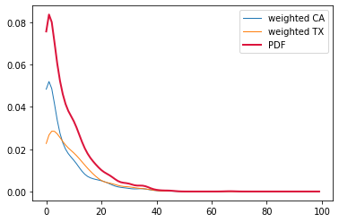
Probability density function (PDF)
This PDF graph plots the total PDF, as well as short-term residents’ reporting of moderate to severe pain in separate states, CA and TX, which are the two highest-frequency states for nursing home establishments.
This is from Q1 2018.

Slide 15
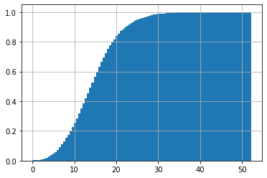
Cumulative density function (CMF)
Cumulative density function plotted for four-quarter average measurements of percentage of long-term nursing home residents reporting increased need for help with daily activities.
The graph tells us that nearly all measurements are between 0 – 30% of all residents in this situation. This helps us to understand how many total residents are reporting these conditions.

Slide 16
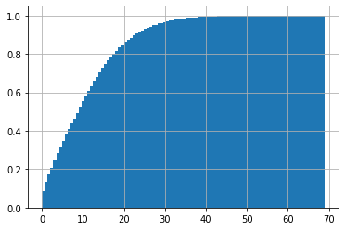
Cumulative density function (CMF)
Cumulative density function plotted for four-quarter average measurements of percentage of short-term nursing home residents reporting experiencing moderate to severe pain.
The graph tells us that nearly all measurements are between 0 – 38% of all residents in this situation. This helps us to understand how many total residents are reporting these conditions.

Slide 17
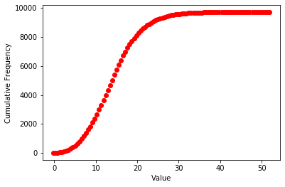
Plotting the normal distribution
This is a plot of the normal distribution of long-term nursing home residents reporting increased need for help with daily activities.
We can see that the curve of our normal distribution appears to be identical to the curve of our CDF. This tells us that we are capturing the entire sample in the dataset.

Slide 18
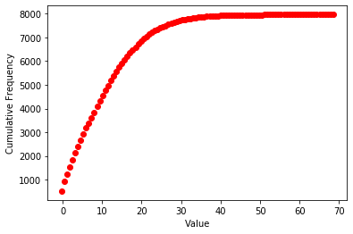
Plotting the normal distribution
This is a plot of the normal distribution of long-term nursing home residents reporting increased need for help with daily activities.
We can see that the curve of our normal distribution appears to be identical to the curve of our CDF. This tells us that we are capturing the entire sample in the dataset.

Slide 19
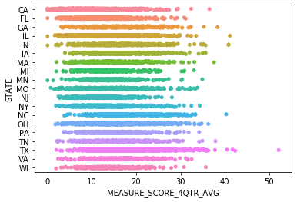
Scatter plots of four-quarter averages vs resident states
This scatter plot is of long-term nursing home residents reporting increased need for help with daily activities and the states in which those reports were recorded.
We can see that while there is great overlap, there is still variance between states of residents reporting that they are in need of more help with daily acitivites.

Slide 20
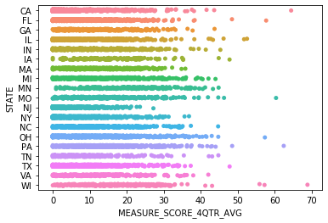
Scatter plots of four-quarter averages vs resident states
This scatter plot is of short-term nursing home residents reporting experiencing moderate to severe pain.
We can see that while there is great overlap, there is still variance between states of residents reporting that they are in pain.

Slide 21
Hypothesis test
For the hypothesis test, a Wilcoxon signed rank test was used to test for statistical significance between Q1 2018 measurements and Q4 2018 measurements.
In both situations, a.) long-term residents reporting increased need for help with daily activities, and b.) short-term residents reporting experiencing moderate to severe pain, p-values well, well below 0.01 were observed.
In other words, our data are unlikely with a true null. Assuming that Q1 and Q4 measurements were uncorrelated, we would obtain the observed difference or more in far less than 1% of investigations due to random sampling error.

Slide 22
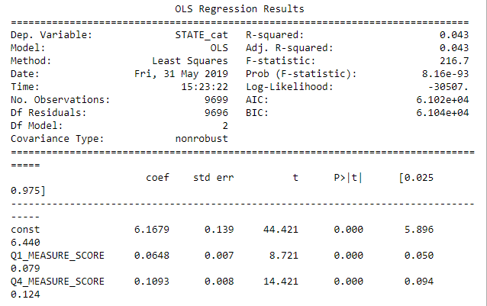
Regression analysis; long-term residents reporting increased need for help with daily activities

Slide 23
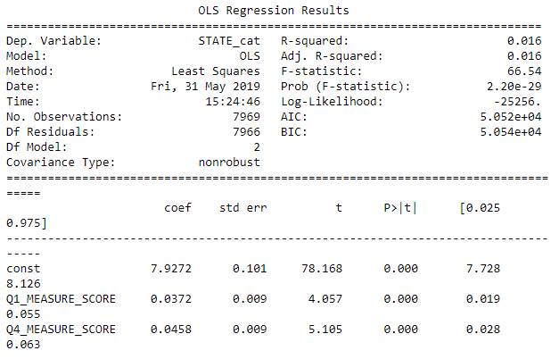
Regression analysis; short-term residents reporting experiencing moderate to severe pain

